Slide 1
ML Algorithms to estimate delivery projects time of Work Books & CR (SDN-GC)
What is the problem I want to solve?
There is a possibility that we can extract relevant data from SDN-GC of already known PID number and CR number ,then we can use work items given to train a model and using them in a ML model to predict the number of weeks of total development required
Our Goals
We aim to create a model which can predict estimate time of projects and Crs related to the SDN-GC as per business needs
Which type of supervised problem we have ?
We want to predict the estimation weeks of a project /Cr by using labelled data
So we see our problem as a supervised learning for estimation prediction using Leaner regression
Defining a number of labels that we want perform in the beginning, we have just picked up
random Crs and projects data as the number of input labels we want to check, and for each label we use Crs details as training data.
Obviously, we just want to have project/ Cr work items values, that are more than 30 projects/Crs as our training data.

Slide 2
Choosing algorithm that we want to use for training the model
There is a specific algorithm that will best-fit to our problem with the some amount of training data that we have, and with good selective features, perhaps choosing the best-fit algorithms will be used in the success of this project
Linear Regression is supervised because the data is used to evaluate the value of the function for the input data to estimate the output
How can we make it?
Creating 3 models to predict the estimation time ,first the regression model using independent variables to predict the value of a dependent variable
The second statistical pattern model using statistic formulas First quartile(Q1),Third quartile(Q3) , Median & Mean
The third Hot-Deck Imputation of the popular Sequential, Random hot-deck algorithm for imputation values
Model Results
From the initial train data , the accuracy of the prediction is around 75% ,since we were using labeled supervised data and we only considered the train data is correct if and only if the predicted label with highest confidence value is correct and from what we got, we are quite happy with the achieved results
Conclusion
This was a very enjoyable project to work on,and this is also we are able to tackle a machine learning problem with estimation data in real life

Slide 3
Data Sample
SDN-GC PID CONS/CR | User interface | DataBase | Modeled Rest API including model changes | eventing /messaging services | Non modeled Rest API | Architectual Enhancement | auditing capabilities | support tools | SDNC Directed Graph | SDNC modeling YANG | Total Development
300365-022618 WORK BOOK | 5 | 4 |  |  | 4 | 2 |  |  | 8 |  | 44
Consolidated 302003 |  | 4 | 6 |  | 2 | 1 |  |  | 2 | 2 | 26
Consolidated workbook 295359 CR 176433 |  | 1 | 2 |  |  |  |  | 3 | 6 |  | 11.5
Consolidated workbook 295359 CR 176623 |  | 2 | 8 |  | 0.5 | 1 |  |  | 10 |  | 26.5
Consolidated workbook 282055c CR 21 |  |  | 2 |  |  |  |  |  | 2 |  | 4
Consolidated workbook 294455b |  | 4 | 12 |  | 5 | 3 |  |  | 20 | 4.5 | 76
Consolidated workbook 295359 CR 178379 |  | 2 | 10 |  |  | 2 |  |  | 10 |  | 33
Consolidated workbook 295793 CR 176370 |  |  | 6 |  |  |  |  |  | 6 |  | 12
Consolidated workbook 298363a CR 177717 |  |  | 5 |  |  |  |  |  | 5 |  | 10
Consolidated workbook 298363a CR 177934 |  |  | 3 |  |  |  |  |  | 4 |  | 7
Consolidated workbook 298363a CR 178166 |  |  | 4 |  |  |  |  |  | 4 |  | 8
Consolidated workbook 298363a CR 178512 |  |  | 10 |  | 1 |  |  |  | 10 | 2 | 27
Consolidated workbook 298368a CR 179147 |  |  | 8 |  |  |  |  |  | 8 |  | 16
Consolidated workbook PID 295793-CR174895 | 1 | 1 | 3 | 1 |  |  | 1 |  | 3 |  | 11.5
workbook 301998 CR 177268 |  |  | 4 |  | 3 |  |  | 4 | 4 |  | 21
Consolidated PID 301033 |  | 1 | 9 |  | 0.75 | 0.5 |  |  | 18 | 1 | 34
Consolidated PID 302423 |  |  | 4 |  | 3 |  |  | 4 | 6 |  | 23

Slide 4
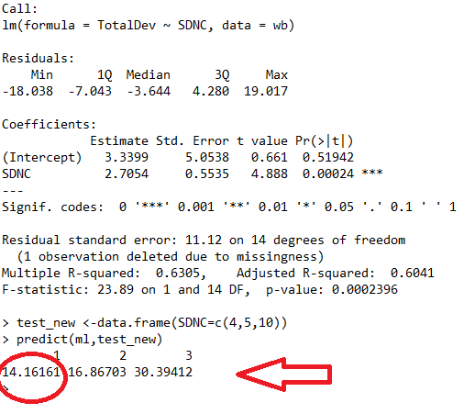
Sample Out put of linear Regression Model
Estimation Predicted Value

Slide 5
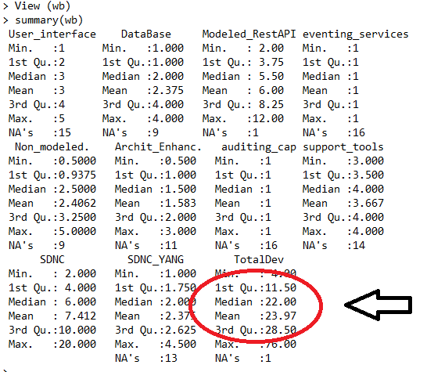
Sample Out put of Statistical Model
Estimation Predicted Value

Slide 6
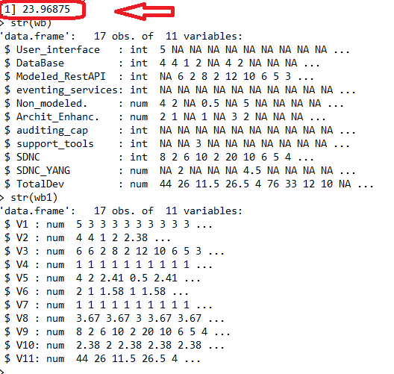
Sample Out put of Hot-Deck Model
Estimation Predicted Value

